Slide 1
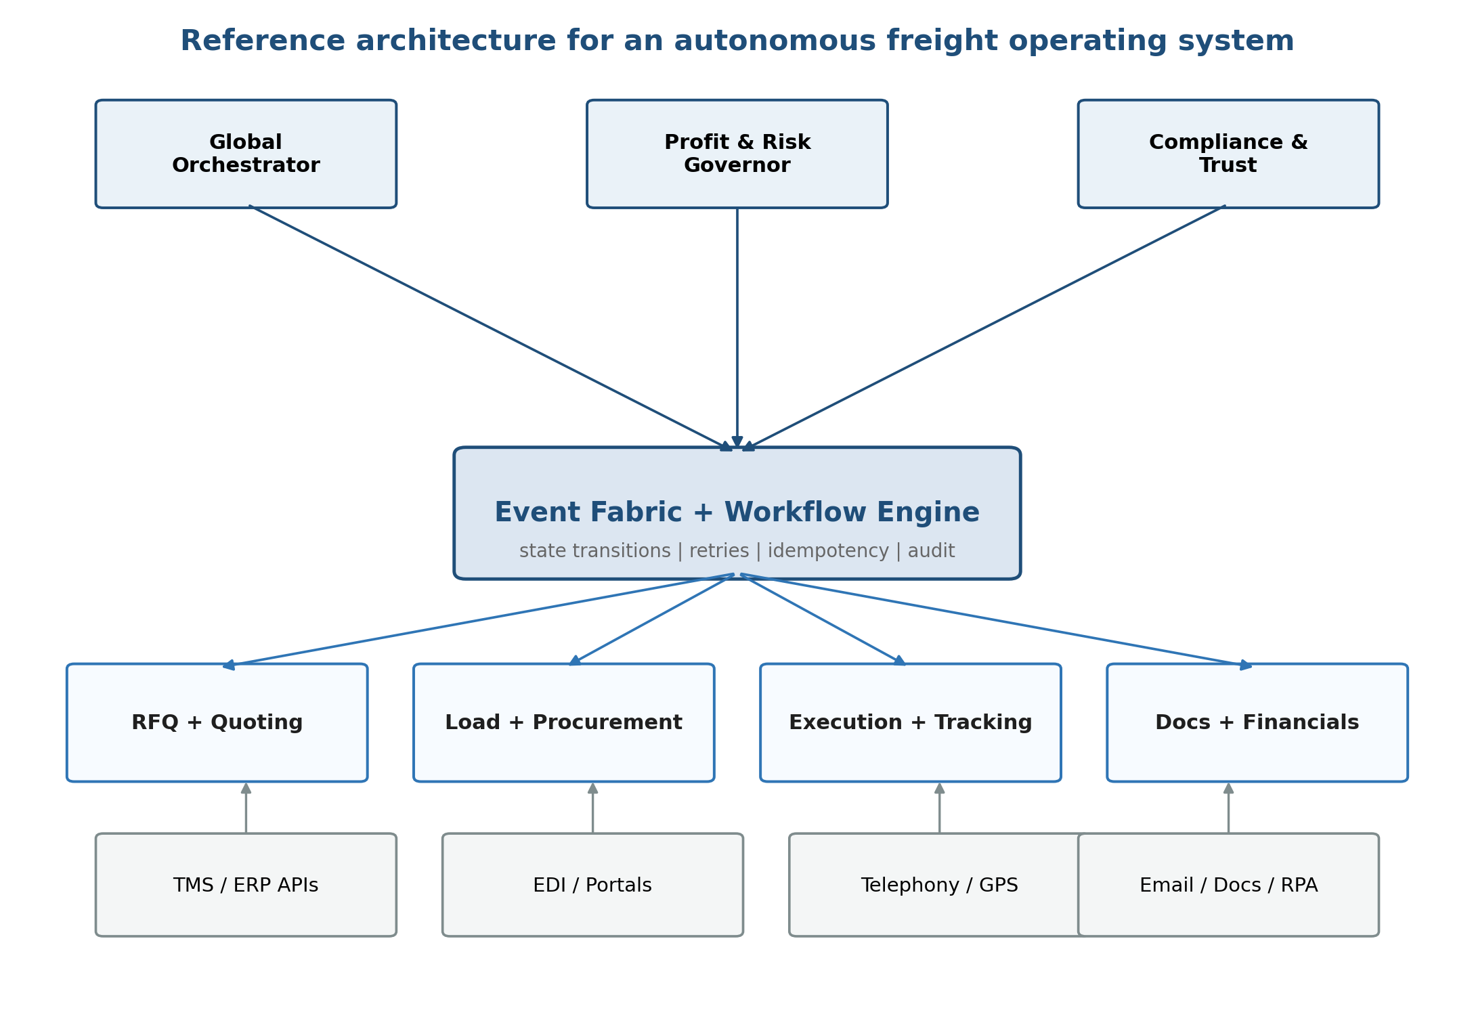
V5 BLUEPRINT
Autonomous
Freight Operating
System
CEO Vision + CTO Architecture
+ Economics + HITL + Commercial Strategy
Venture Summit • April 2026 • Confidential

Slide 2
What’s New in V5
V4 was the technical architecture. V5 adds commercial strategy, financial lifecycle, and the headless north star.
Section | Status | Description
Sections 1–11 | Preserved | Original V4 content with targeted enhancements
Section 6 | Enhanced | Autonomy graduation framework with confidence thresholds
Section 8 | Restructured | Parallel-track rollout with revenue milestone gates
Section 9 | Expanded | Burn model integration, event-based cost model tiers
Section 10 | Expanded | Commercial & operational risks added to architectural risks
Section 12 | NEW | Invoice-to-Cash lifecycle (Ram’s Phase 5)
Section 13 | NEW | Headless Brokerage north star vision (Ram’s Phase 6)
Section 14 | NEW | Customer onboarding & TMS integration playbook
Section 15 | NEW | Competitive positioning & feature parity matrix
Section 16 | NEW | Pricing, packaging, and unit economics
Section 17 | NEW | Compliance as infrastructure (4 domains, hard/soft gates)
Section 18 | NEW | Cross-border customs lifecycle & financial streams

Slide 3
1. Executive Thesis
Not another TMS. An autonomous operating layer that turns freight brokerage
into an event-driven economic control system.
Operating Model
Scalability
Economic Control
North Star
Agents execute routine path;
humans govern exceptions
Headcount rises with
exception volume, not loads
Risk and margin governed
in-line, not discovered late
Headless brokerage:
zero-audit logistics
nervous system
V5 adds "Revenue potential" and "Headless brokerage" to the original thesis

Slide 4
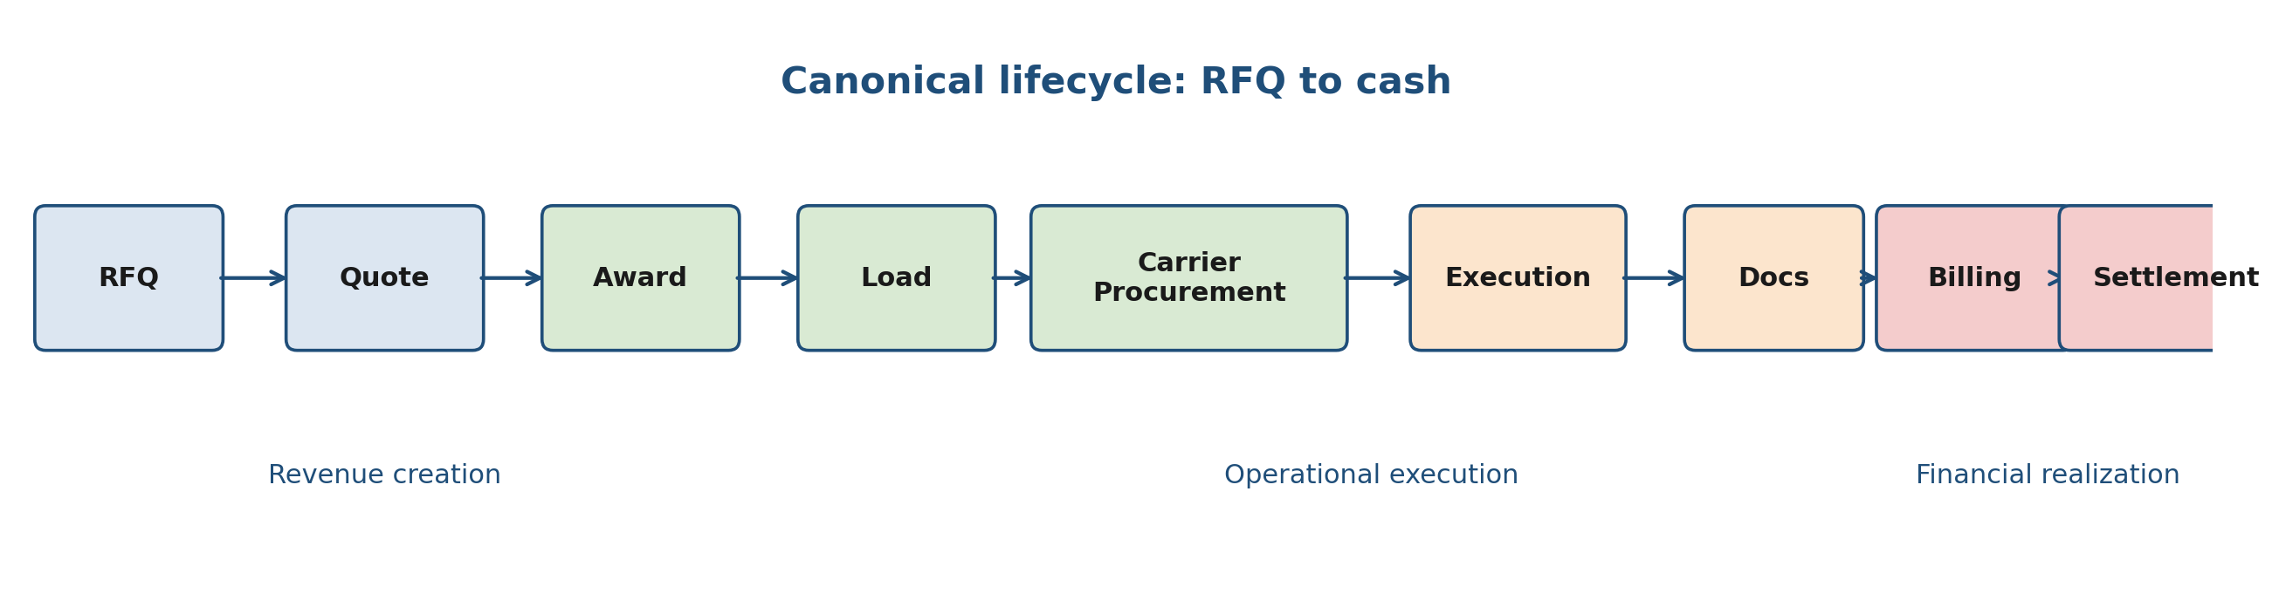
2. Canonical Lifecycle: RFQ to Cash
Figure 1. Canonical lifecycle from inbound demand to financial realization.
Lifecycle Design Rules
• Upstream decisions must preserve downstream financial truth
• Operational completion ≠ billing eligibility (Delivered ≠ Invoice-ready)
• V5: Lifecycle now extends through invoice, settlement, dispute, and cash realization

Slide 5
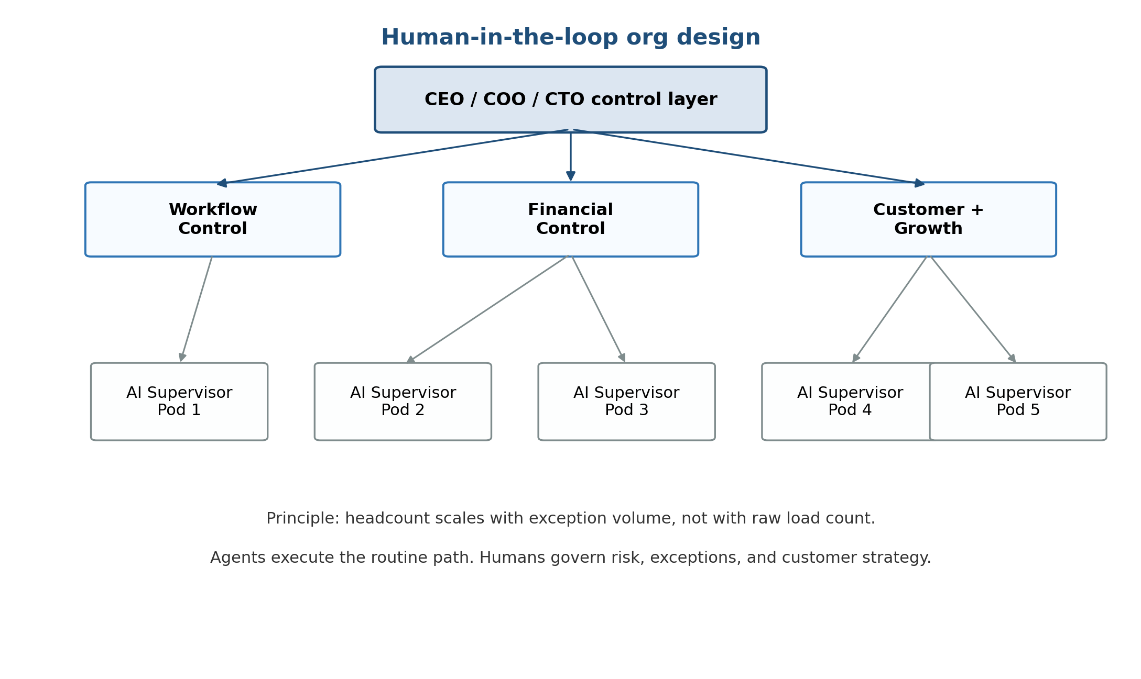
3. Reference Architecture
Executive Control Plane
Orchestration, margin governance,
compliance, trust
Event Fabric + Workflow
State transitions, retries, timers,
escalation, audit logs
Domain Agent Systems
Quoting, procurement, execution,
billing, disputes, settlement
Integration Plane
Sylectus TMS API, DAT APIs,
EDI, GPS/ELD, RPA fallbacks
5 service boundaries: Quoting, Procurement, Execution, Documents, Financials | Anchor: Sylectus + DAT

Slide 6
4–5. State Machines & Agent Hierarchy
Explicit State Machines
Agent Fleet
Object | Core States
RFQ | Received → Parsed → Priced → Sent → Won/Lost
Load | Created → Covered → Dispatched → Transit → Delivered
Documents | Missing → Received → Parsed → Validated
Billing | Pending → Eligible → Issued → Accepted → Paid
Settlement | Pending → Matched → Approved → Paid
Executive
Global Orchestrator, Profit & Risk
Governor, Compliance & Trust
Lifecycle
Intake, Pricing, Carrier Selection,
Tracking, Billing, Settlement, Dispute
Cross-cutting
Memory, Learning, Escalation,
Tool Execution
V5 adds: Rate Audit, Invoice, Payment Match, Settlement, Dispute, and Compliance agents

Slide 7
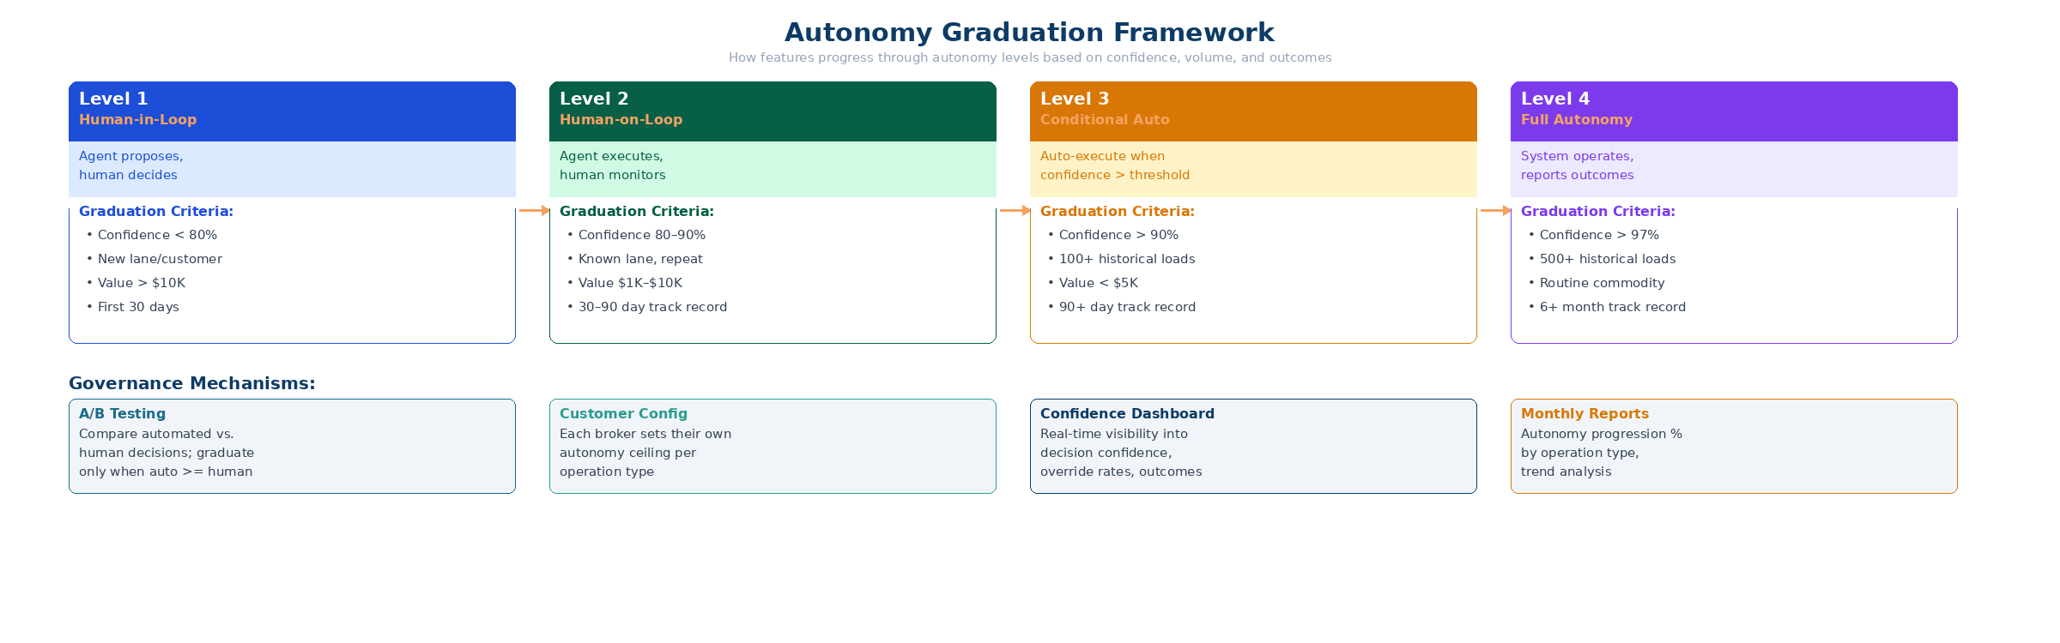
6. HITL Model + Autonomy Graduation
V5 ENHANCED
V5 Enhancement: Features graduate through autonomy levels independently
• Confidence threshold: statistical confidence in decision accuracy
• Volume threshold: minimum historical load count for baseline
• A/B validation: automated vs. human decisions must match or exceed
• Customer consent: each broker sets their own autonomy ceiling
• Monthly reports: % decisions at each level + economic impact

Slide 8
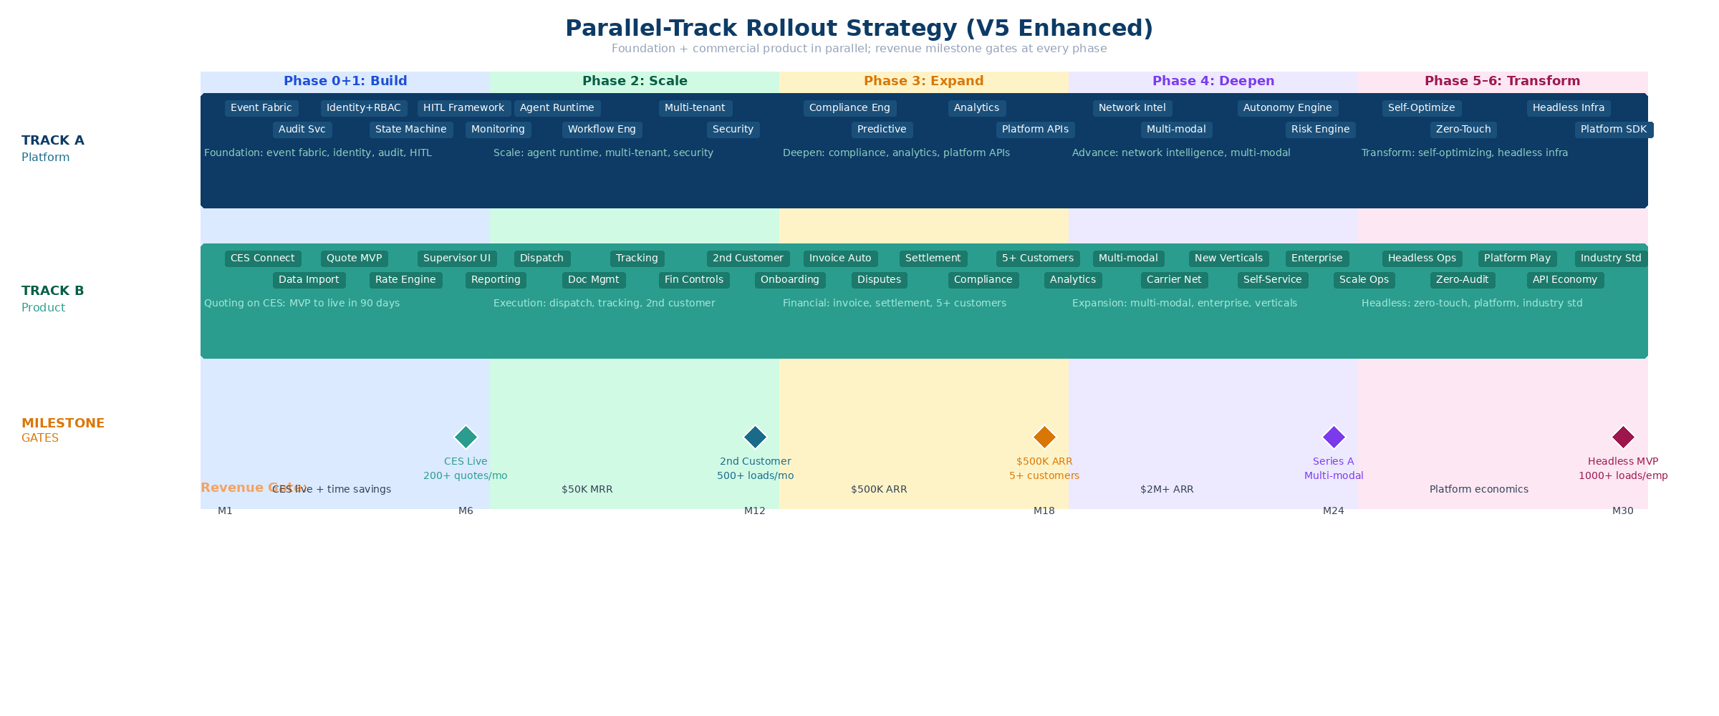
8. Parallel-Track Rollout Strategy
V5 RESTRUCTURED
Phase 0 never exists alone. Foundation runs parallel to commercial product. Revenue gates at every transition.

Slide 9
9. Economics & Scaling Model
V5 EXPANDED
Load Scale | Automation | Team | Loads/Emp | Interpretation
~1K/mo | 70–80% | 6–8 | 125–170 | Prove model; train supervisors
~5K/mo | 80–90% | 15–20 | 250–330 | Exception-centric ops become real
~10K+/mo | 90%+ | 25–35 | 300–500 | Company behaves like software
~50K+/mo | 95%+ | 50–70 | 700–1,000+ | Headless: near-zero marginal cost
Event-Based Cost Model
Core
Professional
Enterprise
$3.08/load
$6.50/load
$9.08/load
69% margin
71% margin
72% margin
Quote + tracking
Full lifecycle
RFQ-to-cash + autonomy

Slide 10
10. Risks & Design Guardrails
V5 EXPANDED
Risk | Severity | Guardrail
Monolithic agents | High | Keep agents narrow, event-driven | V4
Financial over-automation | High | Deterministic policy checks + approval thresholds | V4
CES concentration | High | 2nd customer by M9; multi-tenant from day one | V5 NEW
TMS integration complexity | High | RPA fallback; top 5 TMS only | V5 NEW
Scope creep to Phase 6 | Med | Revenue milestone gates at every phase | V5 NEW
Competitive response | Low–Med | Governed autonomy = 18+ month moat | V5 NEW
Operator resistance | Med | HITL default; opt-in autonomy | V5 NEW
V5 expands risk coverage from 5 architectural risks to 11 risks spanning architecture,
commercial strategy, and operations. Every risk now has a measurable guardrail.

Slide 11
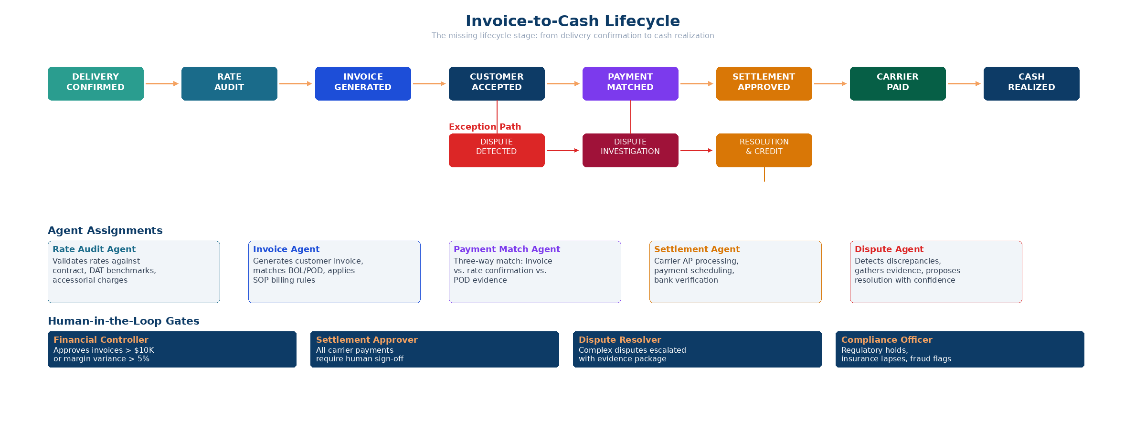
12. Invoice-to-Cash Lifecycle
NEW IN V5
Ram’s Phase 5: Complete context-aware real-time audit, smart payments, dispute resolution, settlement & trust clearing house and compliance management system.

Slide 12
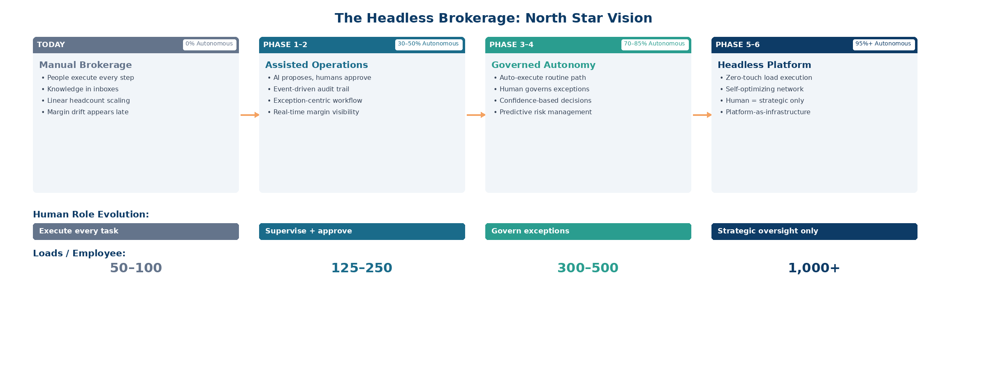
13. Headless Brokerage: North Star
NEW IN V5
Ram’s Phase 6: Headless “full loop” autonomous freight brokerage platform — the “zero-audit” logistics nervous system.

Slide 13
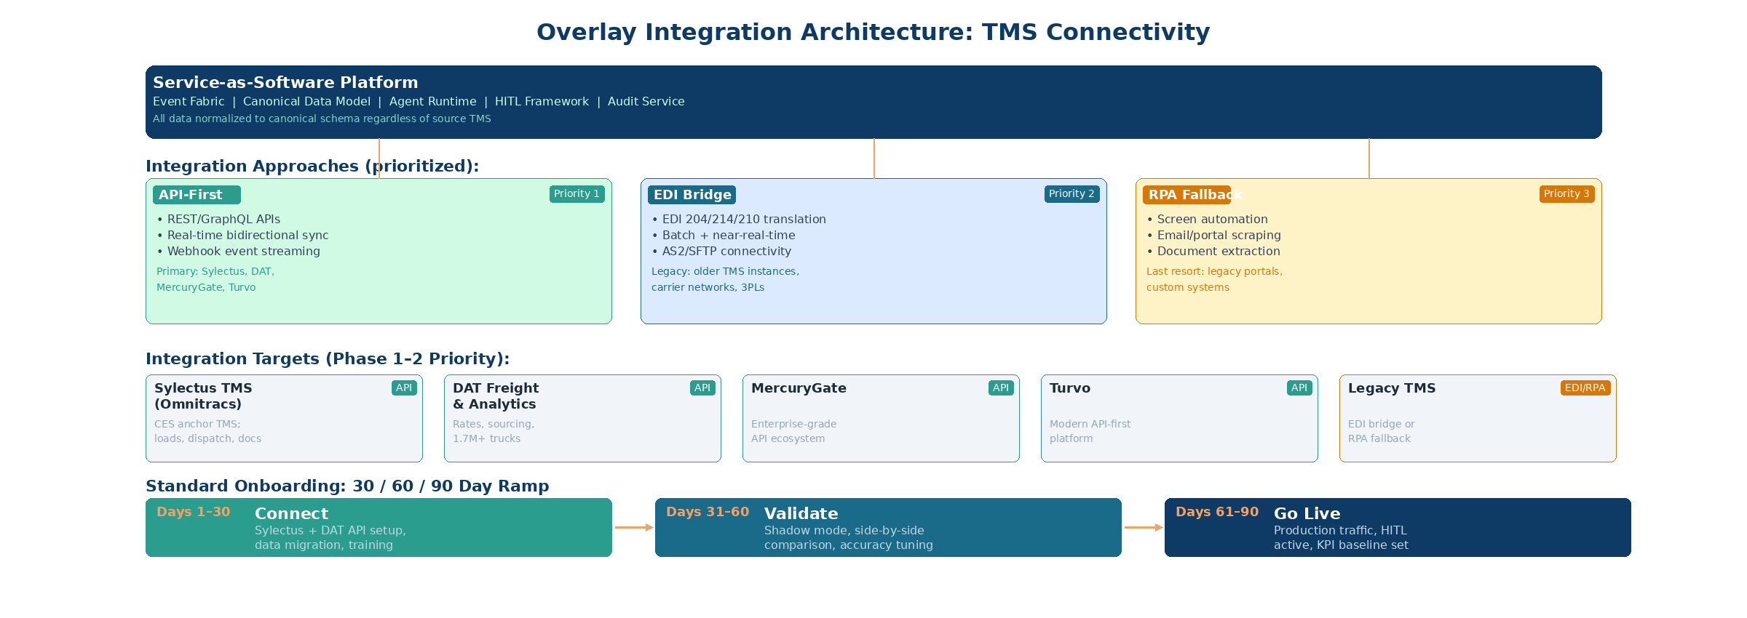
14. Customer Onboarding & TMS Integration
NEW IN V5
30/60/90 Day Ramp: Connect (Sylectus API + DAT API + data) → Validate (shadow mode, accuracy > 85%) → Go Live (production + KPIs)
Primary: Sylectus TMS (API — loads, dispatch, tracking, docs) + DAT (API — rates, carrier sourcing, 1.7M+ trucks) | Future: MercuryGate, Turvo (API), legacy TMS (EDI/RPA)

Slide 14
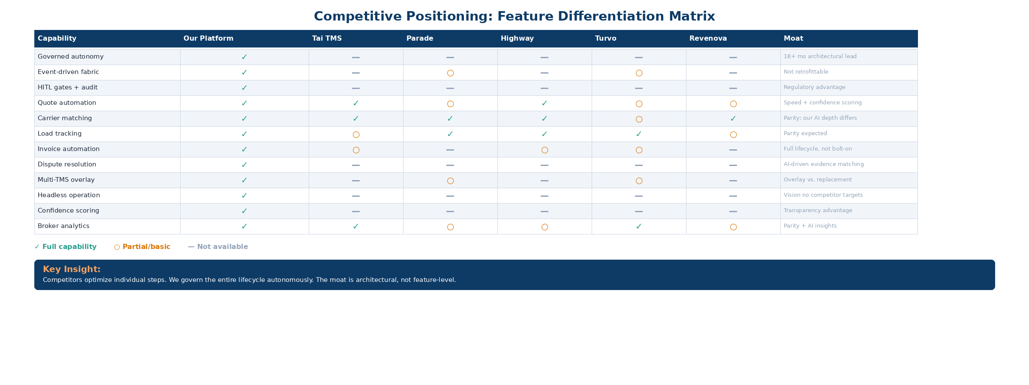
15. Competitive Positioning
NEW IN V5
Competitors optimize individual steps. We govern the entire lifecycle autonomously.
The moat is architectural (event fabric + governed autonomy), not feature-level.

Slide 15
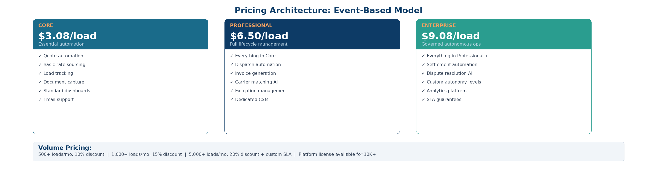
16. Pricing, Packaging & Unit Economics
NEW IN V5
Revenue Expansion: 59x within a single account
Start: Core tier, 200 loads/mo = $616/month
Grow: Enterprise tier, 5,000 loads/mo at 20% discount = $36,320/month
Volume discounts: 500+ (10%) | 1,000+ (15%) | 5,000+ (20%) | 10,000+ (platform license)

Slide 16
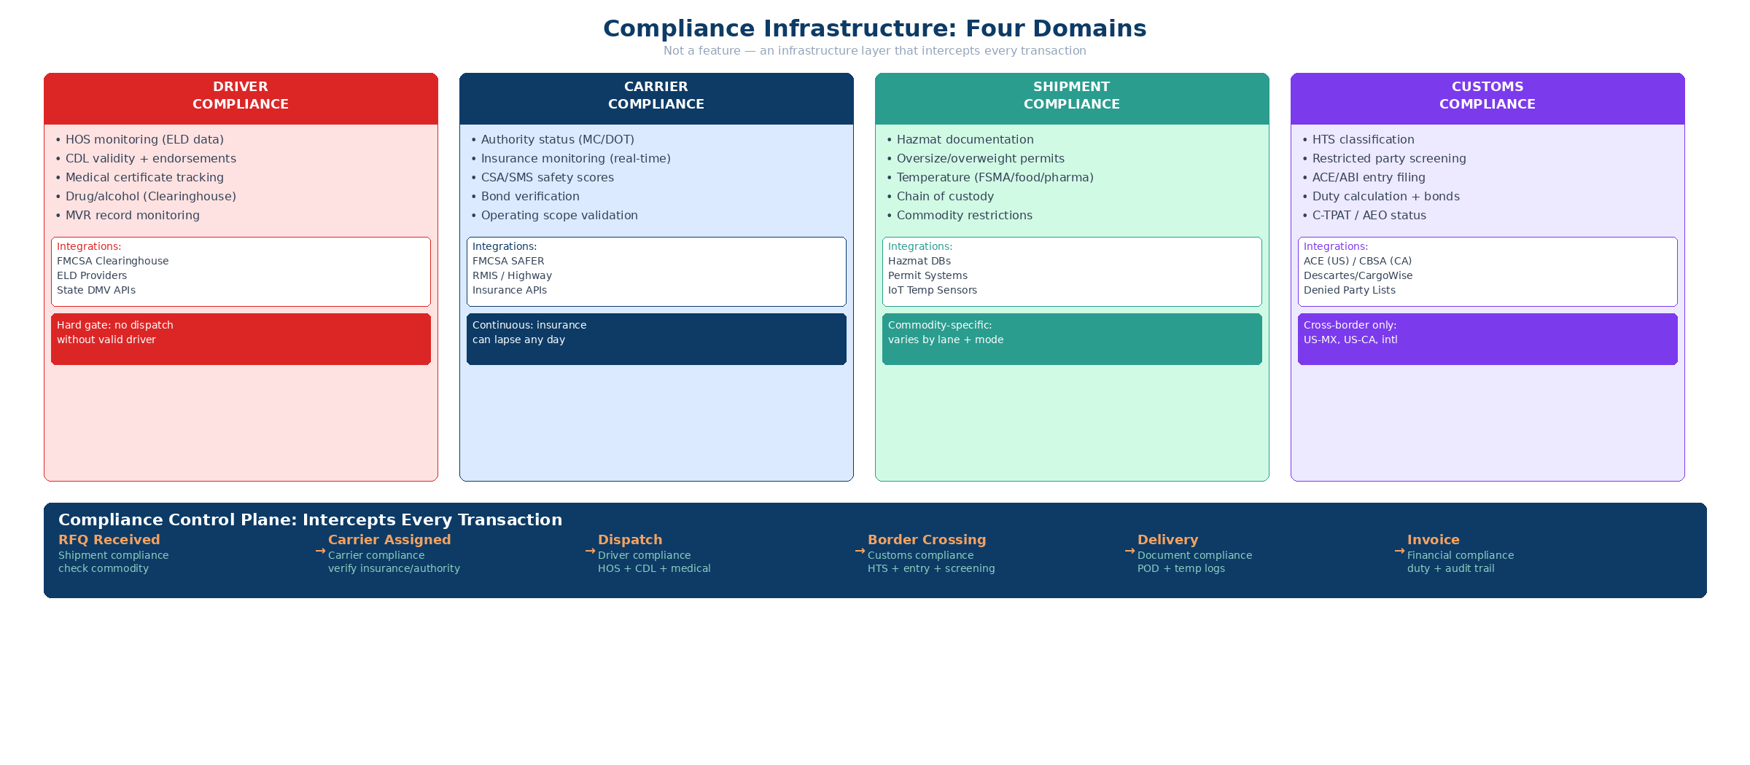
17. Compliance as Infrastructure
NEW IN V5
Hard Gates (Block)
Soft Gates (Flag + HITL)
• Expired carrier insurance
• HOS violation on assigned driver
• Missing hazmat endorsement
• Denied party match (customs)
• CSA score approaching threshold
• Driver nearing HOS limit
• Insurance expiring within 30 days
• HTS confidence < 95%

Slide 17
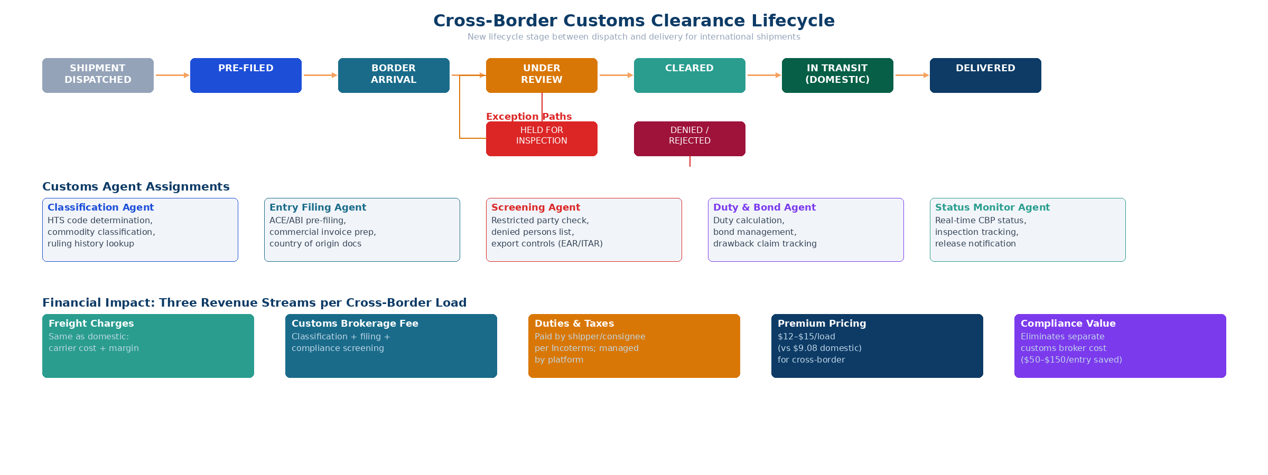
18. Cross-Border Customs Lifecycle
NEW IN V5
Three Financial Streams per Cross-Border Load
Freight Charges
Customs Brokerage
Duties & Taxes
Standard domestic rates
apply to transportation
Per-entry + doc fees
for classification & filing
Pass-through costs:
duties, GST/HST, IVA
Cross-border premium: $12–$15/load vs. $9.08 domestic enterprise | FTA optimization can offset the premium through duty savings

Slide 18
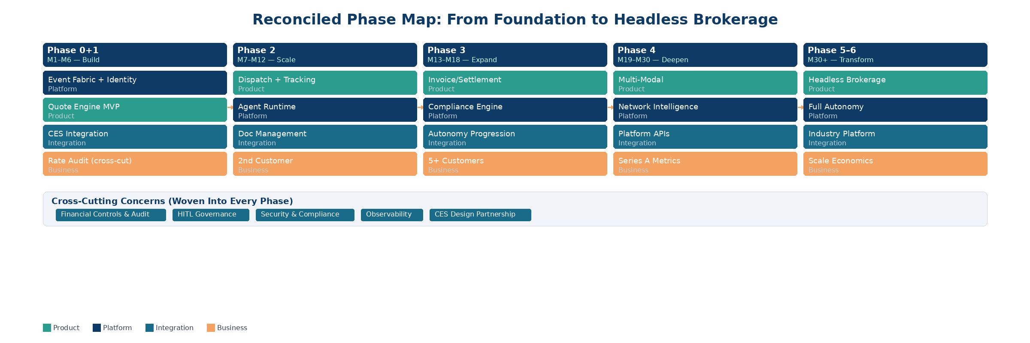
Reconciled Phase Map: V4 → V5
Key V5 Changes to Phase Map:
• Phase 0 + 1 run simultaneously (parallel tracks, not sequential)
• Financial controls are cross-cutting, woven into Phases 1–3 (not deferred to Phase 5)
• Phase 5 redefined: Ram’s audit/payments/disputes/settlement/compliance scope
• Phase 6 added: Headless autonomous platform (Ram’s north star vision)
• Revenue milestone gates required at every phase transition

Slide 19
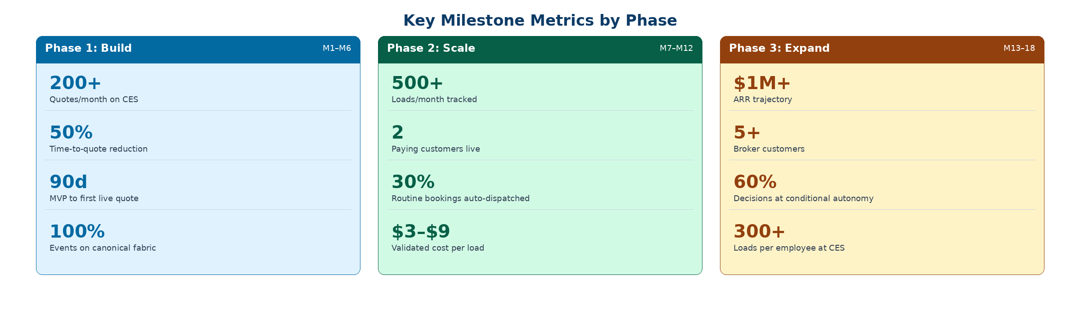
Key Milestone Metrics by Phase
Phase | Product Metric | Business Metric | Autonomy Metric
Phase 1 (M1–6) | Quotes/mo, time-to-quote | CES conversion improvement | % quotes auto-generated
Phase 2 (M7–12) | Loads tracked, exception rate | 2nd customer revenue | % bookings auto-dispatched
Phase 3 (M13–18) | Invoices processed, disputes | ARR trajectory, margin | % at conditional autonomy

Slide 20
V5 Blueprint: Ready for Discussion
18 sections covering the full spectrum:
Technical Architecture (Sections 1–11: lifecycle, architecture, state machines, agents, HITL, UX, economics)
Commercial Strategy (Sections 12–16: invoice lifecycle, headless vision, TMS playbook, competitive positioning, pricing)
Compliance & Cross-Border (Sections 17–18: compliance infrastructure, customs lifecycle, 4 domains, hard/soft gates)
Fundable for investors. Usable by operators. Complete for engineering and commercial execution.
Venture Summit • April 2026 • Confidential

